Slide 1
Processing Orders

Slide 2
Processing Orders
Being able to receive orders from customers is the most important aspect of an online store.
In the sections that follow, we will build on the application to add support for receiving the final details from the user and checking them out.
To keep the process simple, we are going to avoid dealing with payment and fulfillment platforms, which are generally back-end services that are not specific to Angular applications.

Slide 3
Extending the Model
To describe orders placed by users, create a file called order.model.ts in the src/app/model folder and add the following code:
import { Injectable } from '@angular/core';
import { Cart } from './cart.model';
@Injectable()
export class Order {
public id: number;
public name: string;
public address: string;
public city: string;
public province: string;
public postalCode: string;
public country: string;
public shipped = false;
constructor(public cart: Cart) { }
clear(): void {
this.id = null;
this.name = this.address = this.city = null;
this.province = this.postalCode = this.country = null;
this.shipped = false;
this.cart.clear();
}
}
The Order class will be another service, which means there will be one instance shared throughout the application.
When Angular creates the Order object, it will detect the Cart constructor parameter and provide the same Cart object that is used elsewhere in the application.

Slide 4
Updating the Repository and Data Source
In case we need to use mock data for testing let’s update the static.datasource.ts file in the src/app/model folder with the highlighted code:
import { Injectable } from '@angular/core';
import { Product } from './product.model';
import { Observable, from } from 'rxjs';
import { Order } from './order.model';
@Injectable()
export class StaticDataSource
{
private products: Product[] = [
new Product(1, 'Product 1', 'Category 1', 'Product 1 (Category 1)', 100),
new Product(2, 'Product 2', 'Category 1', 'Product 2 (Category 1)', 100),
new Product(3, 'Product 3', 'Category 1', 'Product 3 (Category 1)', 100),
new Product(4, 'Product 4', 'Category 1', 'Product 4 (Category 1)', 100),
new Product(5, 'Product 5', 'Category 1', 'Product 5 (Category 1)', 100),
new Product(6, 'Product 6', 'Category 2', 'Product 6 (Category 2)', 100),
new Product(7, 'Product 7', 'Category 2', 'Product 7 (Category 2)', 100),
new Product(8, 'Product 8', 'Category 2', 'Product 8 (Category 2)', 100),
new Product(9, 'Product 9', 'Category 2', 'Product 9 (Category 2)', 100),
new Product(10, 'Product 10', 'Category 2', 'Product 10 (Category 2)', 100),
new Product(11, 'Product 11', 'Category 3', 'Product 11 (Category 3)', 100),
new Product(12, 'Product 12', 'Category 3', 'Product 12 (Category 3)', 100),
new Product(13, 'Product 13', 'Category 3', 'Product 13 (Category 3)', 100),
new Product(14, 'Product 14', 'Category 3', 'Product 14 (Category 3)', 100),
new Product(15, 'Product 15', 'Category 3', 'Product 15 (Category 3)', 100),
];
getProducts(): Observable<Product[]> {
return from([this.products]);
}
saveOrder(order: Order): Observable<Order> {
console.log(JSON.stringify(order));
return from ([order]);
}
}

Slide 5
Updating the Repository and Data Source (continued)
To manage orders, we need to create a file called order.repository.ts to the src/app/model folder and add the following code:
import { Injectable } from '@angular/core';
import { Observable } from 'rxjs';
import { Order } from './order.model';
import { StaticDataSource } from './static.datasource';
@Injectable()
export class OrderRepository {
private orders: Order[] = [];
constructor(private dataSource: StaticDataSource) { }
getOrders(): Order[]
{
return this.orders;
}
saveOrder(order: Order): Observable<Order>
{
return this.dataSource.saveOrder(order);
}
}

Slide 6
Updating the Feature Module
We need to register the Order class and the new repository as services using the providers property of the model feature module. Update the model.module.ts file in the src/app/model folder:
import { NgModule } from '@angular/core';
import { ProductRepository } from './product.repository';
import { StaticDataSource } from './static.datasource';
import { Cart } from './cart.model';
import { Order } from './order.model';
import { OrderRepository } from './order.repository';
import { RestDataSource } from './rest.datasource';
import { HttpClientModule } from '@angular/common/http';
@NgModule({
imports: [HttpClientModule],
providers: [ProductRepository, StaticDataSource, Cart, Order, OrderRepository,
{provide: StaticDataSource, useClass: RestDataSource}]
})
export class ModelModule { }

Slide 7
Collecting the Order Details
The next step is to gather the details from the user required to complete the order.
Angular includes built-in directives for working with HTML forms and validating their contents.
We need to prepare the checkout component, by switching to an external template, receiving the Order object as a constructor parameter, and provide some additional support to help the template.

Slide 8
Collecting the Order Details (continued)
We need to prepare for a form by replacing the code in the checkout.component.ts file in the src/app/store folder with the following code:
import { Component } from '@angular/core';
import { NgForm } from '@angular/forms';
import { OrderRepository } from '../model/order.repository';
import { Order } from '../model/order.model';
@Component({
templateUrl: 'checkout.component.html',
styleUrls: ['checkout.component.css']
})
export class CheckoutComponent
{
orderSent = false;
submitted = false;
constructor(public repository: OrderRepository,
public order: Order) { }
submitOrder(form: NgForm): void
{
this.submitted = true;
if (form.valid)
{
this.repository.saveOrder(this.order).subscribe(order => {
this.order.clear();
this.orderSent = true;
this.submitted = false;
});
}
}
}

Slide 9
Collecting the Order Details (continued)
The @Component decorator’s styleUrls property is used to specify one or more CSS stylesheets that should be applied to the content in the component’s template.
To provide validation feedback for the values that the user enters into the HTML form elements, we need to create a file called checkout.component.css in the src/app/store folder and defined the styles shown below:
input.ng-dirty.ng-invalid
{
border: 2px solid #ff0000;
}
input.ng-dirty.ng-valid
{
border: 2px solid #6bc502;
}

Slide 10
Collecting the Order Details (continued)
The final piece of the puzzle is the template for the component, which presents the user with the form fields required to populate the properties of an Order object.
Create a file called checkout.component.html in the src/app/store folder with the following code:
<div class="container-fluid">
<div class="row">
<div class="col bg-dark text-white">
<a class="navbar-brand">SPORTS STORE</a>
</div>
</div>
</div>
<div *ngIf="orderSent" class="m-2 text-center">
<h2>Thanks!</h2>
<p>Thanks for placing your order.</p>
<p>We'll ship your goods as soon as possible.</p>
<button class="btn btn-primary" routerLink="/store">Return to Store</button>
</div>
<form *ngIf="!orderSent" #form="ngForm" novalidate
(ngSubmit)="submitOrder(form)" class="m-2">
<div class="form-group">
<label>Name</label>
<input class="form-control" #name="ngModel" name="name"
[(ngModel)]="order.name" required />
<span *ngIf="submitted && name.invalid" class="text-danger">
Please enter your name
</span>
</div>

Slide 11
Collecting the Order Details (continued)
<div class="form-group">
<label>Address</label>
<input class="form-control" #address="ngModel" name="address"
[(ngModel)]="order.address" required />
<span *ngIf="submitted && address.invalid" class="text-danger">
Please enter your address
</span>
</div>
<div class="form-group">
<label>City</label>
<input class="form-control" #city="ngModel" name="city"
[(ngModel)]="order.city" required />
<span *ngIf="submitted && city.invalid" class="text-danger">
Please enter your city
</span>
</div>
<div class="form-group">
<label>Province</label>
<input class="form-control" #province="ngModel" name="province"
[(ngModel)]="order.province" required />
<span *ngIf="submitted && province.invalid" class="text-danger">
Please enter your province
</span>
</div>

Slide 12
Collecting the Order Details (continued)
<div class="form-group">
<label>Zip/Postal Code</label>
<input class="form-control" #postalCode="ngModel" name="postalCode"
[(ngModel)]="order.postalCode"
required
/>
<span *ngIf="submitted && postalCode.invalid" class="text-danger">
Please enter your zip/postal code
</span>
</div>
<div class="form-group">
<label>Country</label>
<input class="form-control" #country="ngModel" name="country"
[(ngModel)]="order.country" required />
<span *ngIf="submitted && country.invalid" class="text-danger">
Please enter your country
</span>
</div>
<div class="text-center">
<button class="btn btn-secondary m-1" routerLink="/cart">Back</button>
<button class="btn btn-primary m-1" type="submit">Complete Order</button>
</div>
</form>

Slide 13
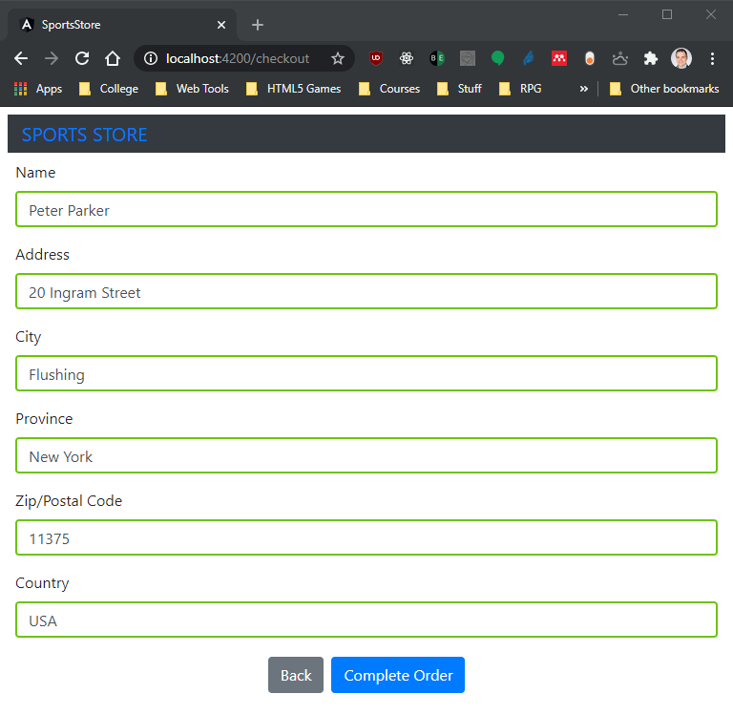
Collecting the Order Details (continued)
To see the process, start with the list of products and click one of the Add To Cart buttons to add a product to the cart.
Click the Checkout button and you will see the HTML form:

Slide 14
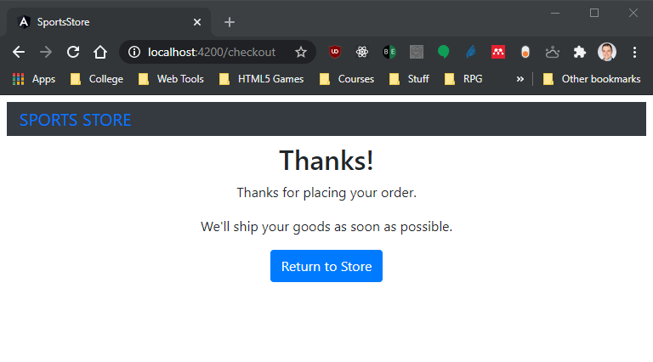
Collecting the Order Details (continued)
Fill out the form and click the Complete Order button; you will see the confirmation message:

